Slide 1
HOW TO WIN AT MONOPOLY ?

Slide 2
The key to success in Monopoly is noticing that not all properties are created equal. This is where Statistics steps into help.

Slide 3
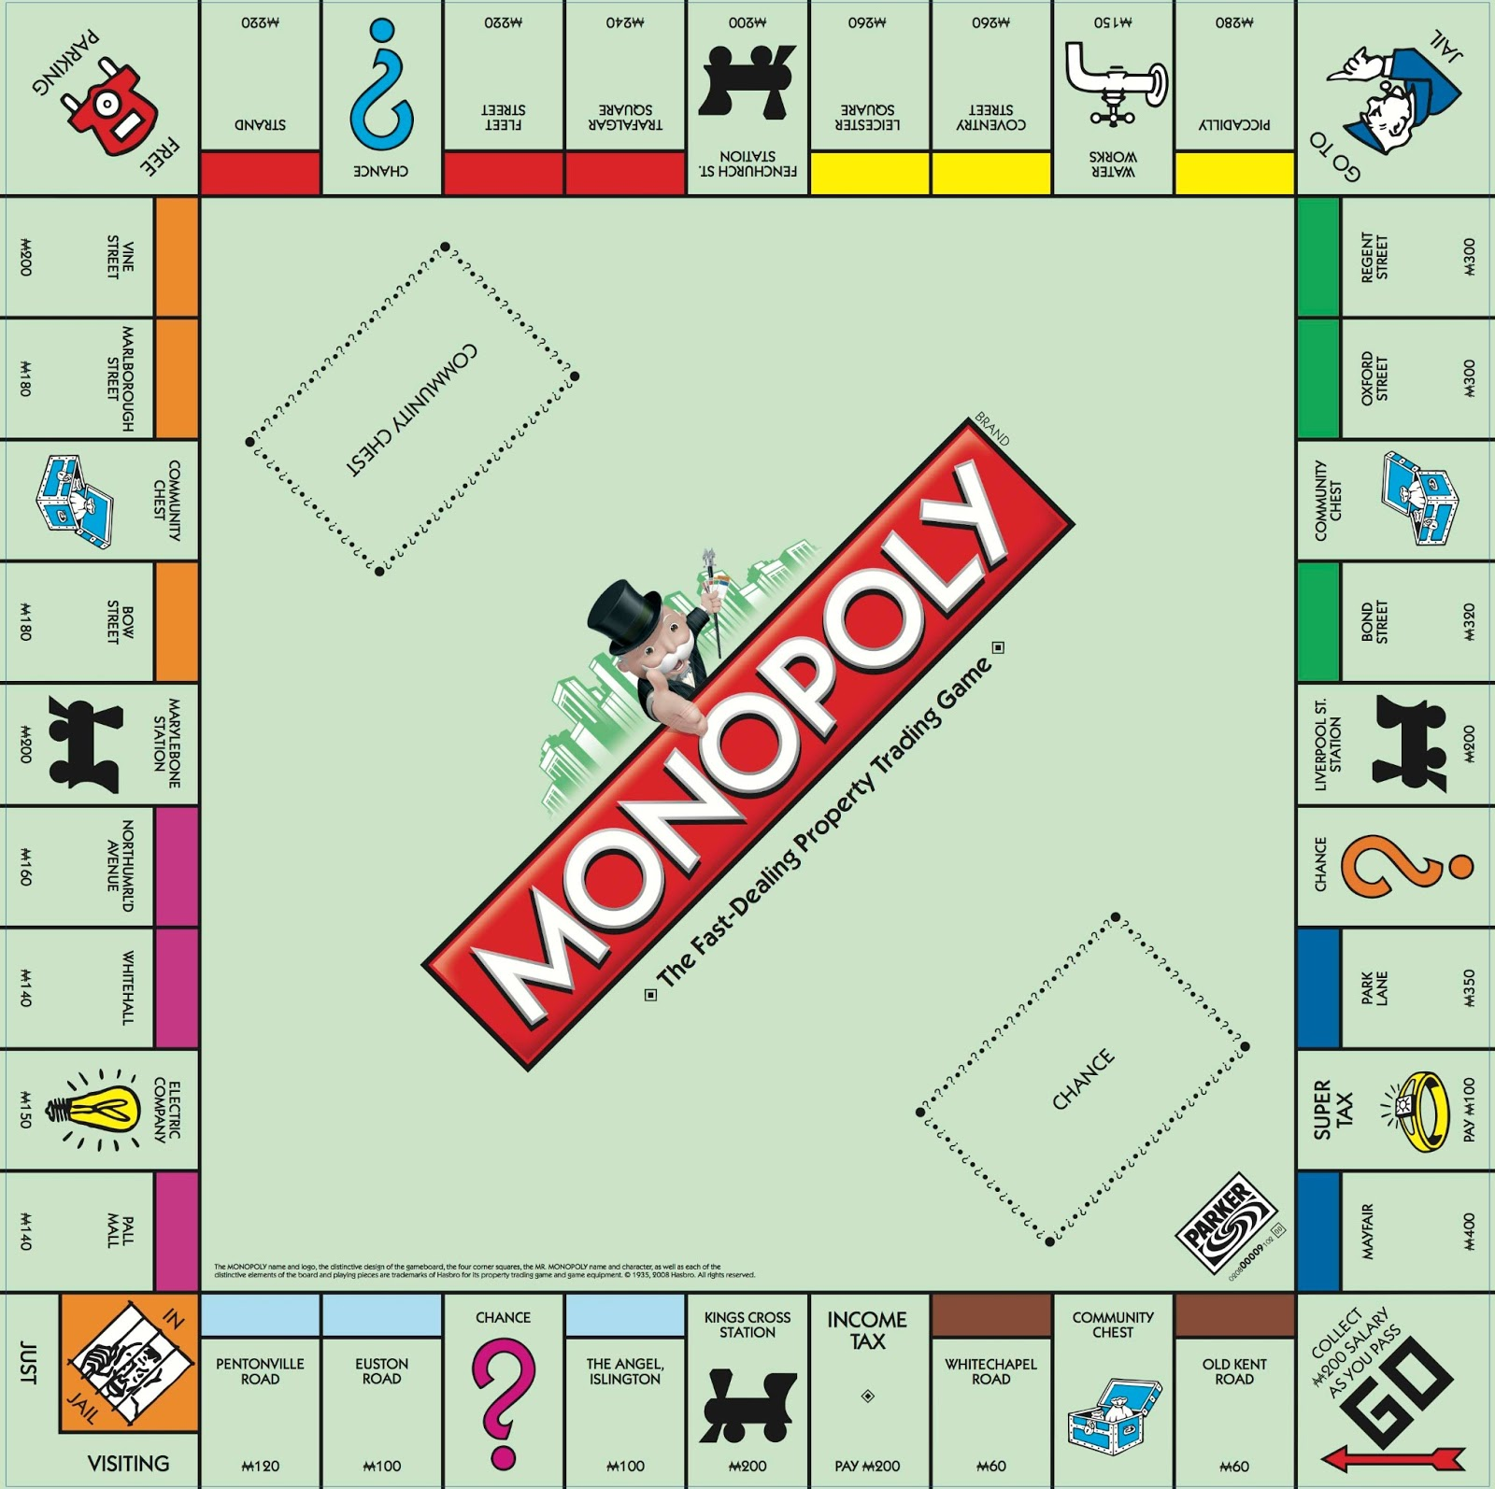
MONOPOLY BOARD

Slide 4
OBJECTIVE OF THE PROJECT
To model the game of Monopoly as a Markov chain
To find which is the most probable square on the board
To find out the most profitable property sets on the board
To find the best strategy to win the game

Slide 5
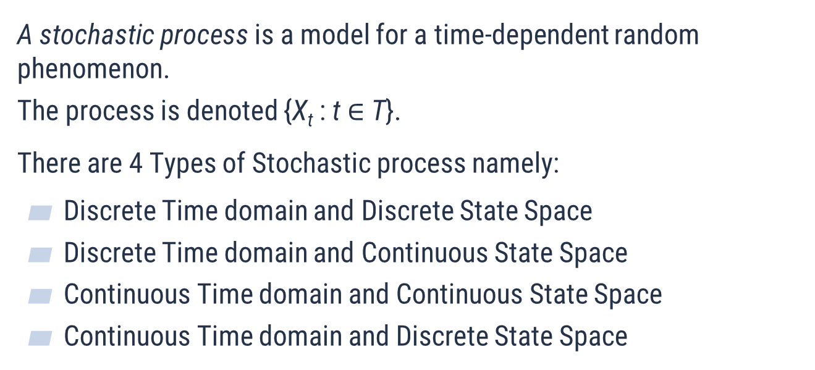
STOCHASTIC PROCESS
A stochastic process is a model for a time-dependent random phenomenon.
The process is denoted {X_{t} : t $∈$ T}.
There are 4 Types of Stochastic process namely:
Discrete Time domain and Discrete State Space
Discrete Time domain and Continuous State Space
Continuous Time domain and Continuous State Space
Continuous Time domain and Discrete State Space

Slide 6
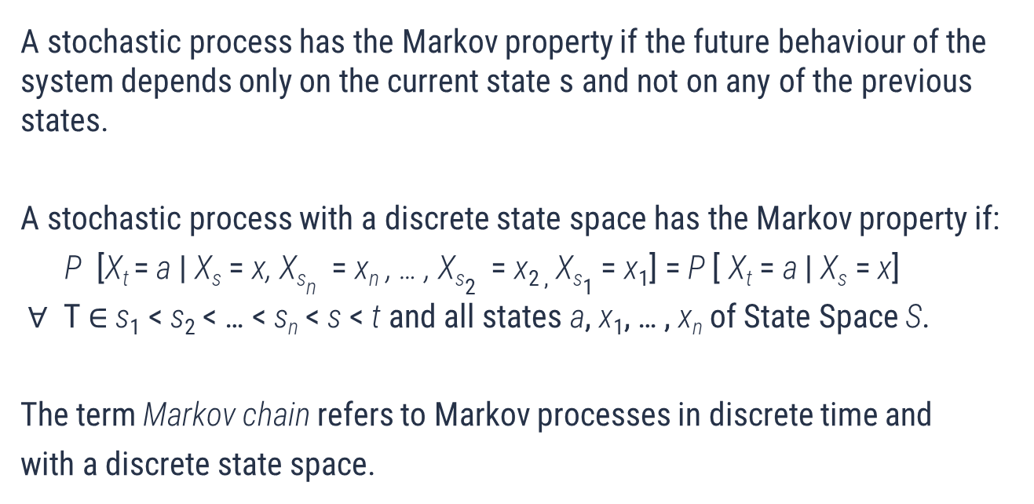
MARKOV CHAIN
A stochastic process has the Markov property if the future behaviour of the system depends only on the current state s and not on any of the previous states.
A stochastic process with a discrete state space has the Markov property if:
P [X_{t} = a | X_{s} = x, X_{sn} = x_{n} , … , X_{s2} = x_{2 ,} X_{s1} = x₁] = P [ X_{t} = a | X_{s} = x]
$∀$ T $∈$s₁ < s₂ < … < s_{n} < s < t and all states a, x₁, … , x_{n} of State Space S.
The term Markov chain refers to Markov processes in discrete time and
with a discrete state space.

Slide 7
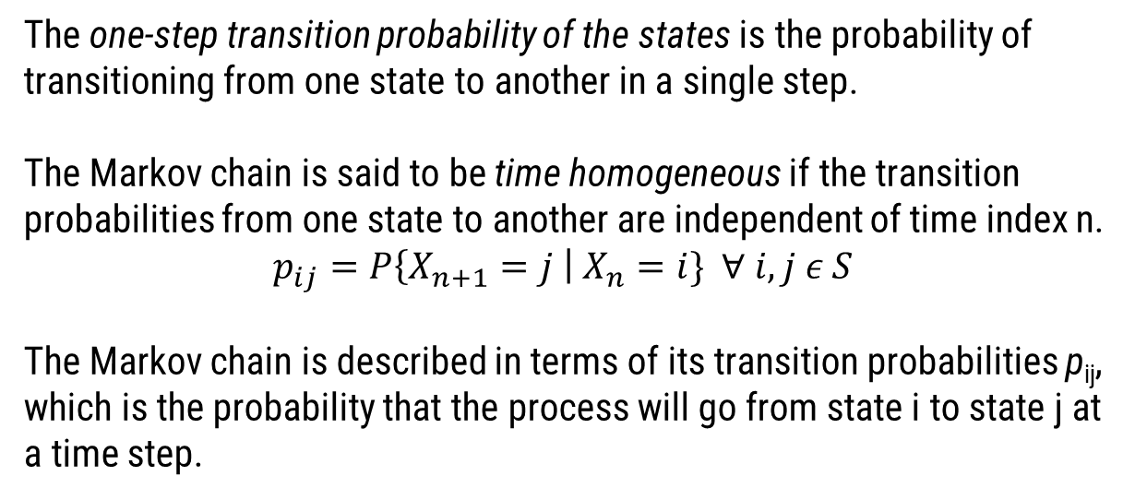
Transition Probability
The one-step transition probability of the states is the probability of transitioning from one state to another in a single step.
The Markov chain is said to be time homogeneous if the transition probabilities from one state to another are independent of time index n.
$$p_{ij}=P\left\{X_{n+1}=j \right| X_{n}=i\} ∀ i,j ε S$$
The Markov chain is described in terms of its transition probabilities p_{ij}, which is the probability that the process will go from state i to state j at a time step.

Slide 8
Basics of monopoly
There are 40 squares including properties, tax, utilities, chance, community chests and stations.
In the model each turn becomes the unit of time and the Squares become the States.
There are 16 chance and community chests.
Player starts from the first square which is go.
Player rolls 2 dices in each turn.
The player buys properties and earns revenue when another player lands on it.
Players can build houses and hotels on a set to earn higher revenue.
Basic motto is to not go bankrupt.

Slide 9
Monopoly As a markov chain
We model the probability of landing on a Square in a turn on a given monopoly space as a Markov chain.
This means that the probability of landing on a Square depends on the current square and not on any earlier history. Thus it satisfies Markov Property.

Slide 10
assumptions
The player does not get sent to jail after 3 doubles.
The chance and community chest cards are shuffled before each turn.
Only property costs and revenue are considered, ignoring the other monetary transactions since they remain same for all players.
The players are assumed to pay and get out of jail immediately.
All trades between players are carried out at the respective monetary values.

Slide 11
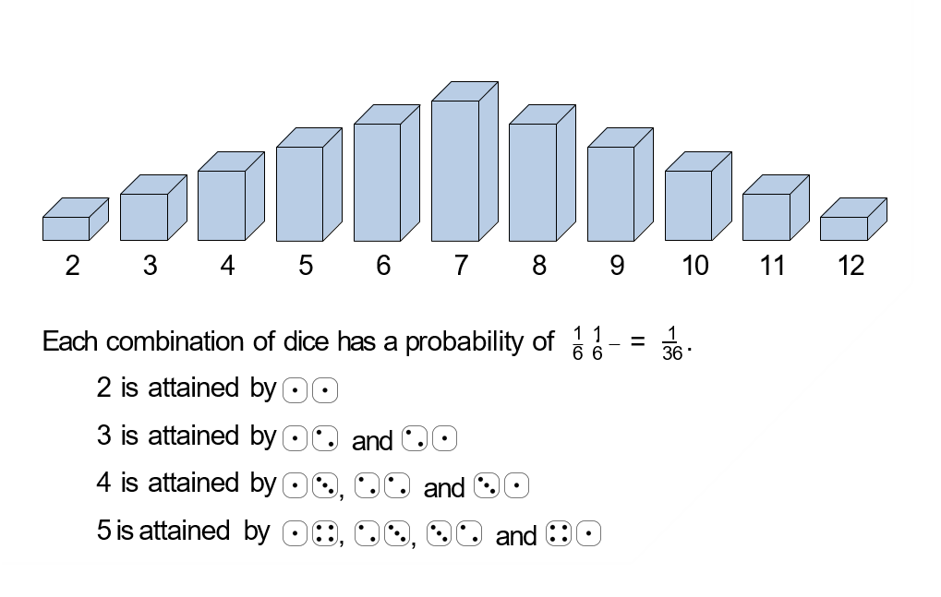

Probability distribution of ROLLING two dice
2 3 4 5 6 7 8 9 10 11 12
$$\frac{1}{6}∗\frac{1}{6}=\frac{1}{36}$$
A
*

Slide 12
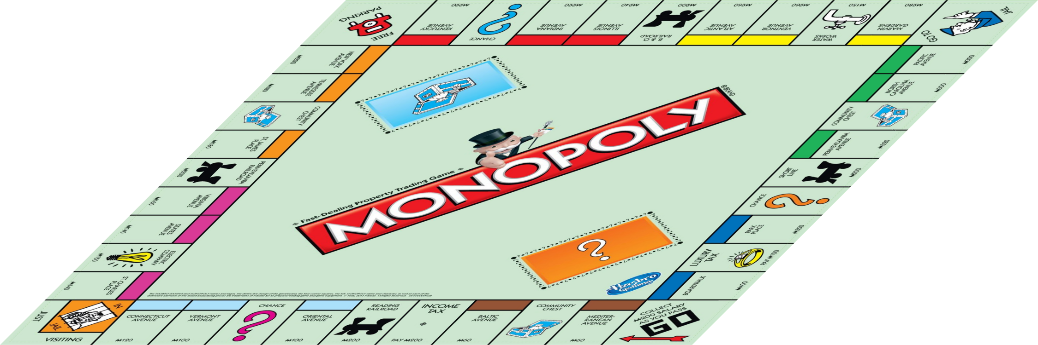

Slide 13


Transition Matrix

Slide 14
Steady state Probability
There are two ways of finding the steady state distributions
Theoretical – Using the Transition matrix and R markov chain package we got the following results
Simulation – Using Python we simulated the entire game 10^9 times and got the following results.

Slide 15
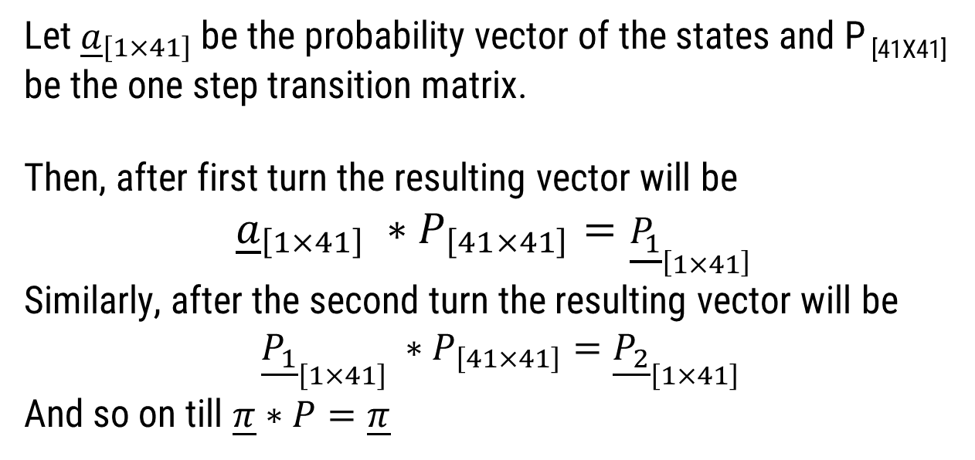
Steady state Probability
Let ${\underline{a}}_{\left[1×41\right]}$be the probability vector of the states and P _{[41X41]} be the one step transition matrix.
Then, after first turn the resulting vector will be
$${\underline{a}}_{\left[1×41\right]} ∗P_{\left[41×41\right]}={\underline{P_{1}}}_{\left[1×41\right]}$$
Similarly, after the second turn the resulting vector will be
${\underline{P_{1}}}_{\left[1×41\right]} ∗P_{\left[41×41\right]}={\underline{P_{2}}}_{\left[1×41\right]}$
And so on till $\underline{π}∗P=\underline{π}$

Slide 16
Initial Probability Distribution
Move count: 0

Slide 17
Move count: 1

Slide 18
Move count: 2

Slide 19
Move count: 3

Slide 20


Move count: 4

Slide 21


Move count: 5

Slide 22

Move count: 6

Slide 23

Move count: 7

Slide 24


Move count: 8

Slide 25

Move count: 9

Slide 26
Move count: 10

Slide 27

Steady State
Move count: ∞

Slide 29
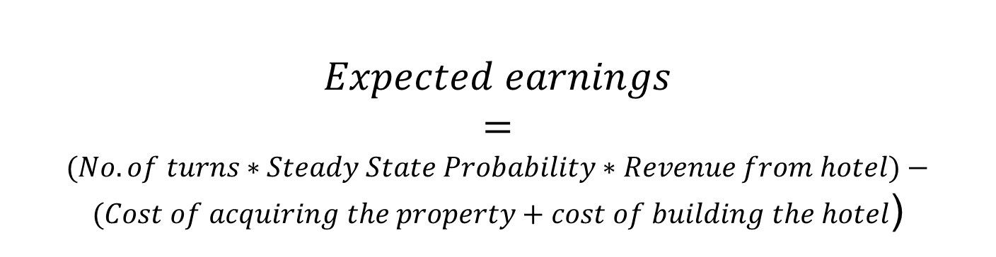
EXPECTED EARNINGS
$$Expected earnings$$
$$=$$
$(No. of turns∗Steady State Probability∗Revenue from hotel)−(Cost of acquiring the property+cost of building the hotel$)

Slide 30
SO WHICH ARE THE BEST PROPERTIES?
* Hotels can be made without owning all the properties of the set.

Slide 31
WHICH SETS TO SET YOUR EYE ON?
..

Slide 32
HOW MANY HOUSES TO BUILD?

Slide 33
CONCLUSION
When playing against just one opponent go for Orange or Light Blue sets, the same is true with more opponents but only in the early stages of the game.
In a game against 2-3 Opponents the properties to target are Orange or Red.
Any more than 3 Opponents, Green becomes you best chance at success.
Build 3 houses on your properties as quickly as you can, wait until you have sufficient cash to invest further.
Utilities are a Dead Investment.

Slide 34
LIMITATIONS
The chance and community chest cards are not put at the bottom of the pile after they’re drawn.
Monetary transactions other than property costs and revenue are ignored.
Instances where a player gets out of jail without paying money are neglected.
The rule where the player goes to Jail on rolling 3 doubles in a row have been not taken into consideration.

Slide 35
